Slide 1
Requirements Document
Coaching Events is a mini social network for communicate coach with their followers, with the objective than they go to their conferences, like an event social network, need to be possible list the events, than on the creation moment required a date, type and location.
The coach need to have a page where can edit, delete and obviously add an event to the list.
The followers and lovers of this kind of events, can follow their favorites coachs, and receive a notification when their favorites coach add or modify an event.
Users need to have the possibility to search upcoming events by coach, type and location to add it to their activity calendar.
When the user follow an coach their upcoming events need to be visible on his feed.

Slide 2
Autentication
Sign Up
Login
Log Out
Change Password
Edit profile

Slide 3
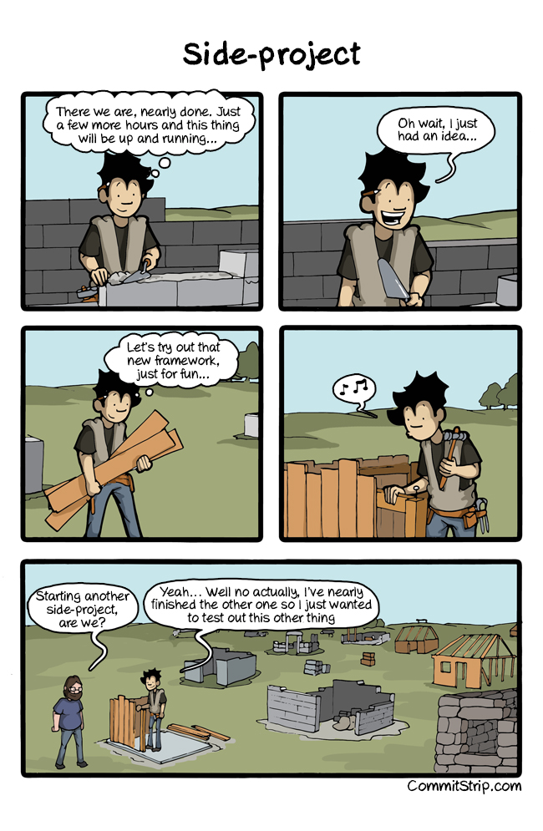

Slide 4
Events
Add an Event
My upcoming events
Edit an Event
Delete an Event
View all upcoming events
Search Events
View Events Details

Slide 5
Calendar
Add Event to a Calendar
Remove Event From calendar
View Events than I’m attending for
😲

Slide 6
Following
Follow a Coach
Unfollow a Coach
Who I’m following
Event feed based on who I’M following
😲

Slide 7
Dependencies
1
2
3
4
5
use case 1 use case 2 use case 4 ----- -----
use case 3 use case 5
use case 6

Slide 8
1
2
3
4
5
Add Event My Upcoming events Edit an event View events i’m attending Remove a event from calendar
All upcoming events Remove an event See who i’m following unfollow a coach
add a event to calendar See feed
follow a coach
Search
View Event details

Slide 9
1
2
3
4
5
Add Event My Upcoming events Edit an event View events i’m attending Remove a event from calendar
All upcoming events Remove an event See who i’m following unfollow a coach
add a event to calendar See feed
follow a coach
Search
View Event details

Slide 10
1
2
3
4
5
Add Event My Upcoming events Edit an event View events i’m attending Remove a event from calendar
All upcoming events Remove an event See who i’m following unfollow a coach
add a event to calendar See feed
follow a coach
Search
View Event details

Slide 11
1
2
3
4
5
Add Event My Upcoming events Edit an event View events i’m attending Remove a event from calendar
All upcoming events Remove an event See who i’m following unfollow a coach
add a event to calendar See feed
follow a coach
Search
View Event details

Slide 12
Starting the Iterations
Never code without sketch

Slide 13
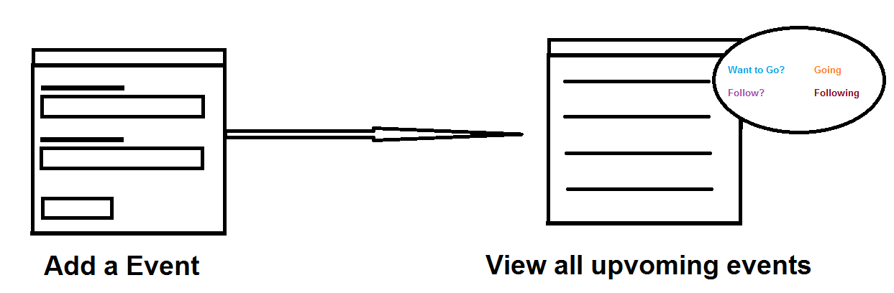

Slide 14
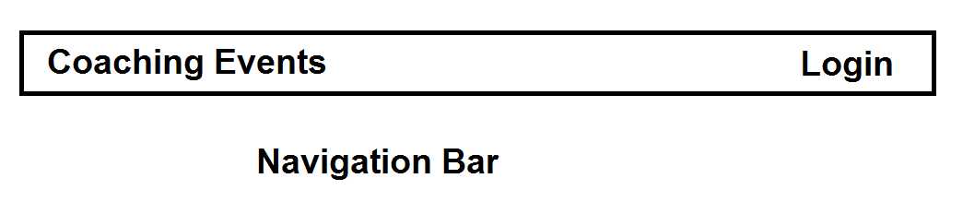

Slide 15
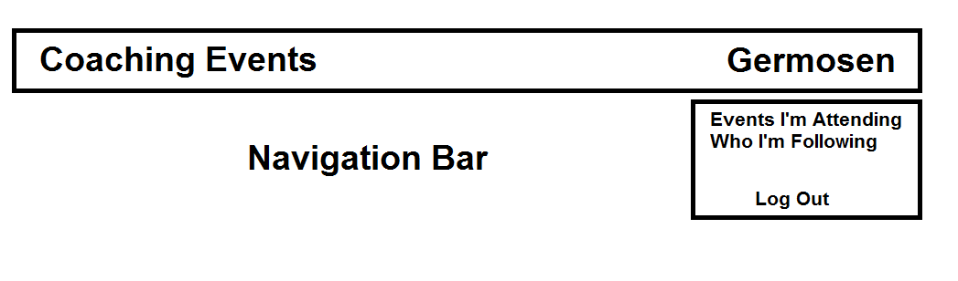

Slide 16
Summary
We met the teacher.
We saw the knowledge and the way of work that we are going to implement.
We knew about .Net Core, differences between their predecesor, and the templates.
We learn about versión control systems and use one program for it.

